Slide 1
Power write
What are the different ways we can represent data?
Notes:
hook

Slide 2
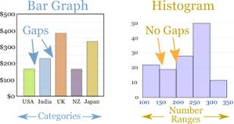
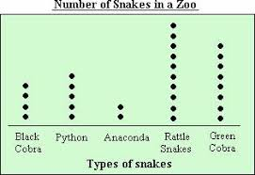
24
7
30
Date
Histograms and Dot plots
EQ – How can you determine which data display is best?
Histogram: A graph with bars showing the frequency of class intervals. A way of displaying continuous data. (there should be no gaps between the bars)
Dot plot: A number line with the frequency of scores represented by the number of dots above each points
5

Slide 3
From the activities we did last week.
What is the best way to represent the data?
Reaction Time:
Word search:
Math Problem solving:
Lolly throw:
Mental Maths:
Notes:
Check for understanding

Slide 4
Making a Histogram for Reaction time
Sort the data into a frequency table
Draw your axes
Draw your graph using the frequency table
Class intervals | Frequency
0 to 0.1
0.1 to 0.2
Notes:
Guided practice

Slide 5
Represent the data
Display the data for each of the activities.
Choose which display is best.
You must have at least one dot plot and one histogram, but feel free to use other display we have learnt. (box and whisker etc.)
Notes:
Independent practice

